Slide 1
Developer Exchange Group
深入淺出設計模式#4:
工廠模式
Prepare by Sean Hsieh

Slide 2
Agenda
Simple Factory method
Factory pattern
Abstract Factory pattern

Slide 3
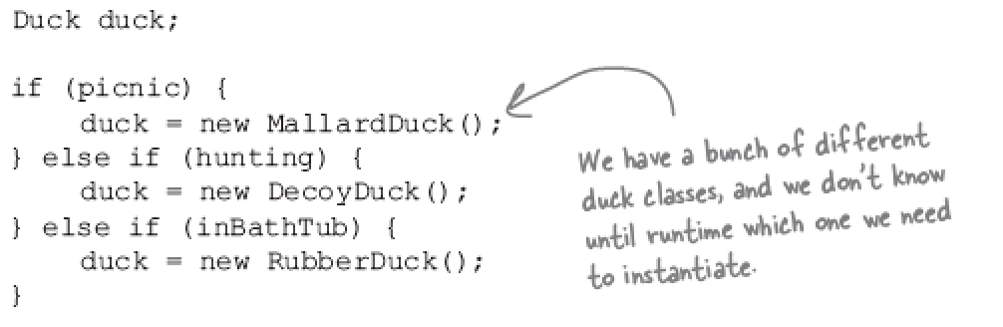
“New” means Concrete
 Program to interface/supertype, not an implementation
 Not good:
ex. MalardDuck duck = new MalardDuck();
 More flexible:
ex. Duck duck = new MalardDuck();

Slide 4
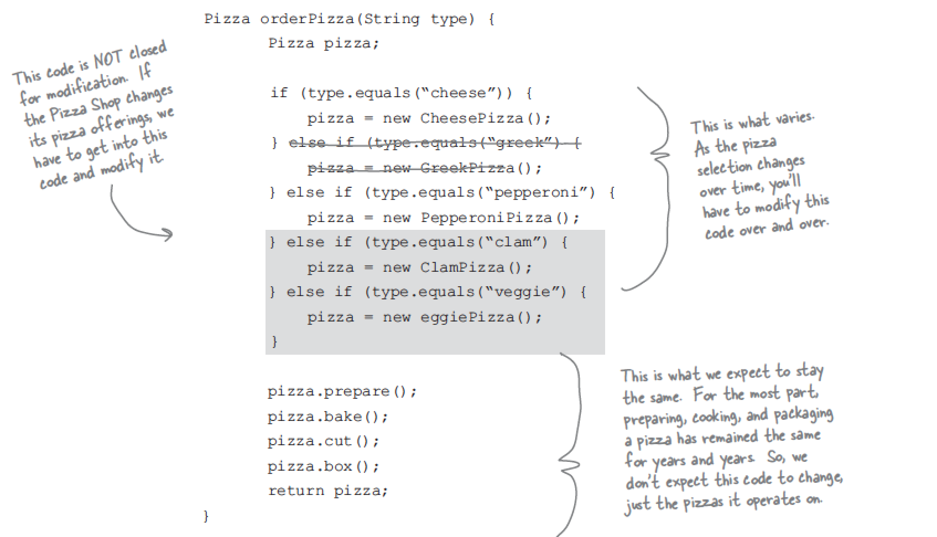
Scene
A pizza shop
Pizza selection will change over time

Slide 5
What ‘s wrong?
1. The code is not closed for modification.
If pizza selection changed, we have to modify it.
2. Concrete for some class will prevent it from being closed for modification.

Slide 6
Simple Factory method

Slide 7
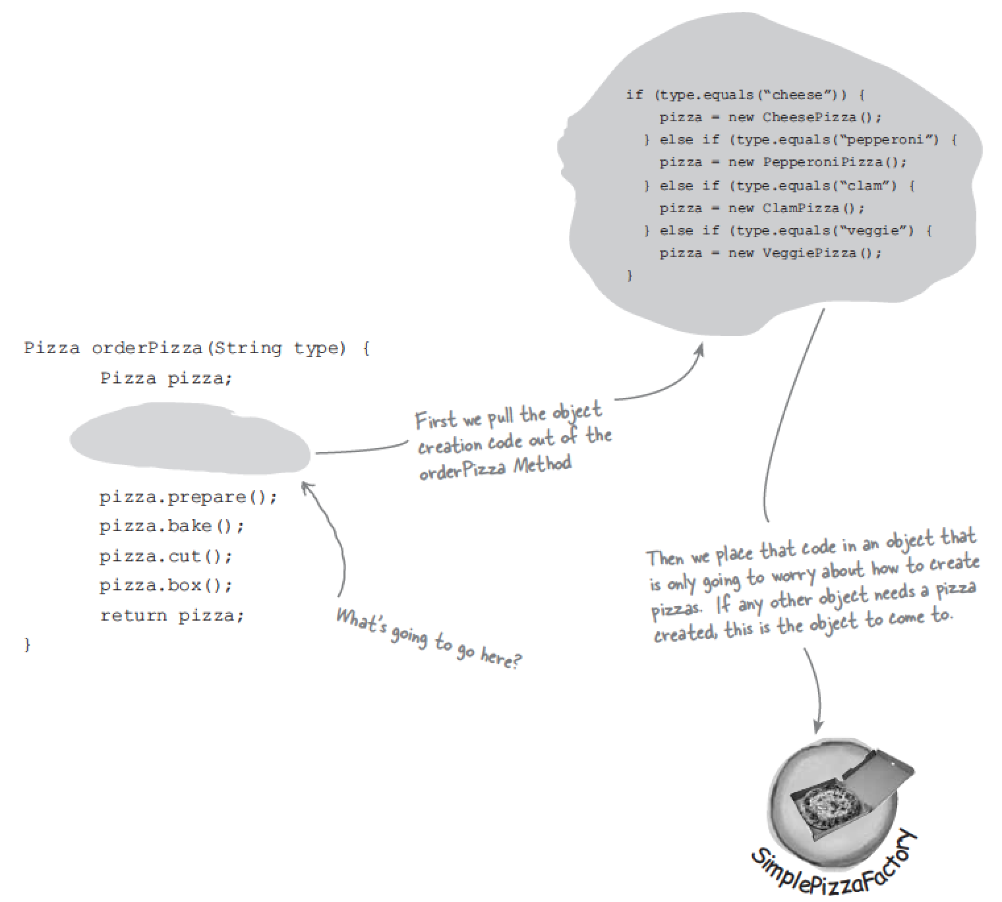
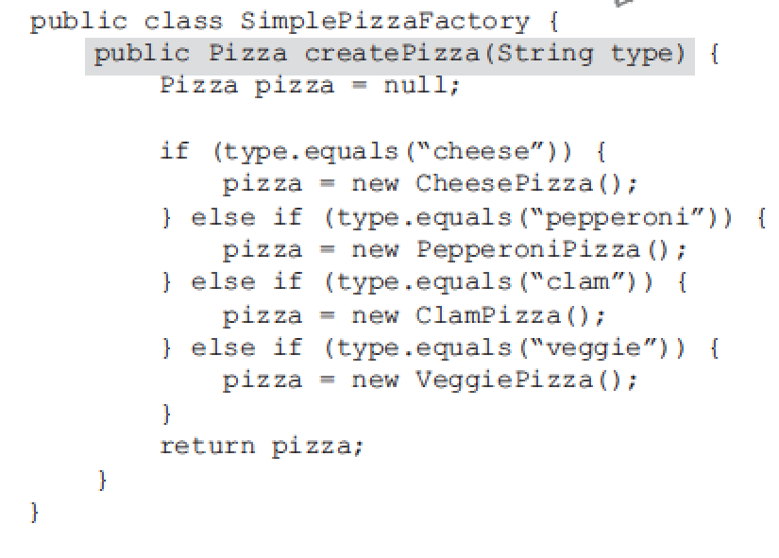
Simple Factory method
The simple factory method isn’t actually a Design Pattern; it’s more of a programming idiom.

Slide 8
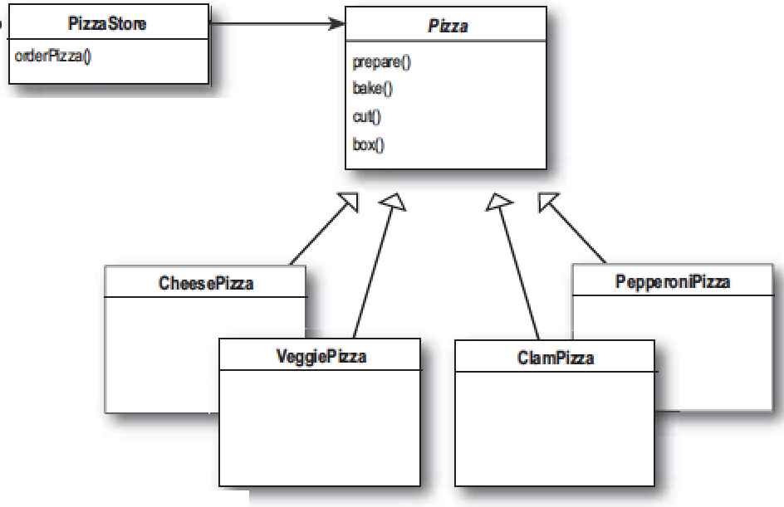
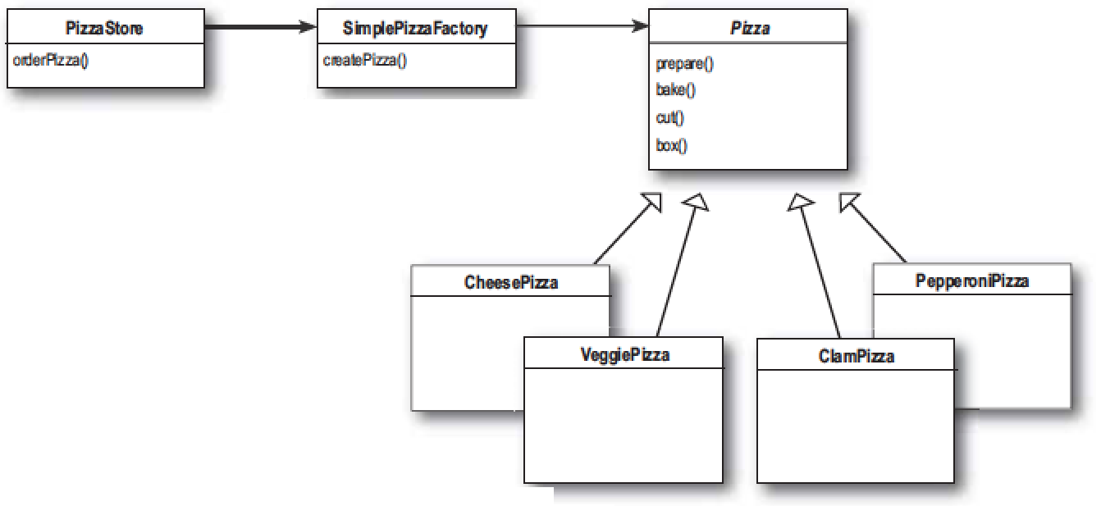
Class diagram of Simple Factory method
Concrete class

Slide 9
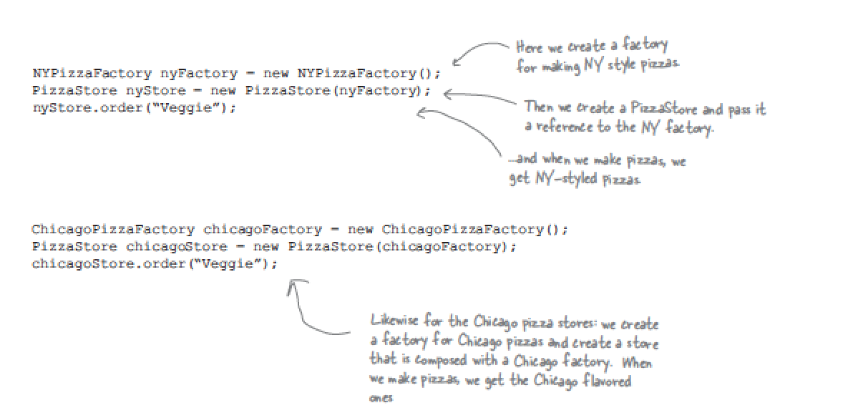
Using Simple Factory method

Slide 10
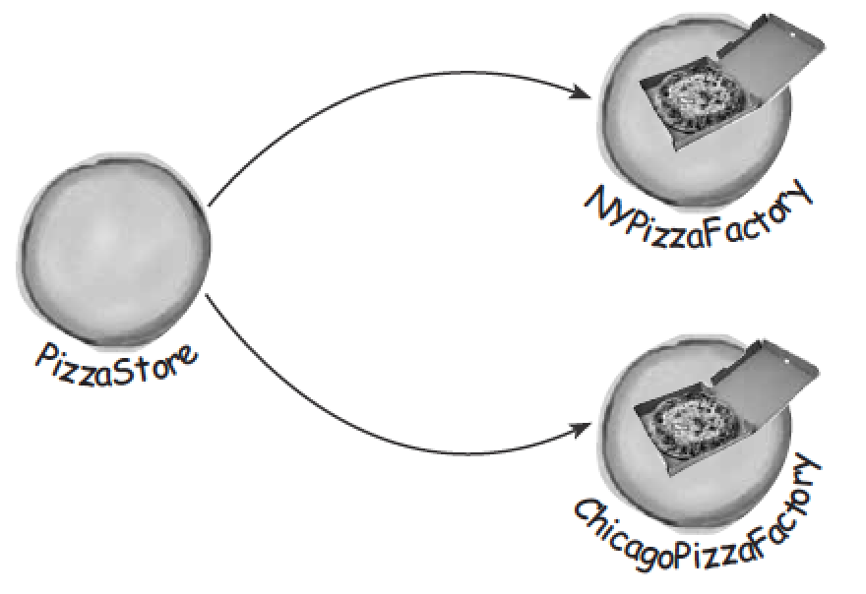
If we have regional differences?
If the regional difference is the part which we fixed before?

Slide 11
Factory pattern

Slide 12
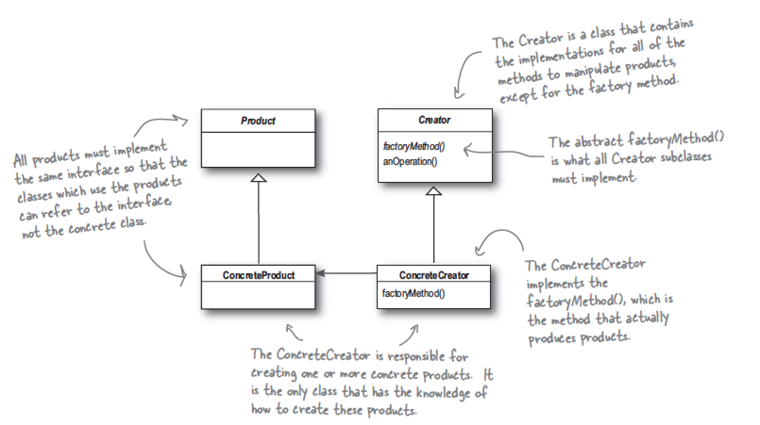
What is Factory Pattern?
The Factory Method Pattern = Creator + Product.
defines an interface for creating an object, but lets subclass decide which class to instantiation.

Slide 13
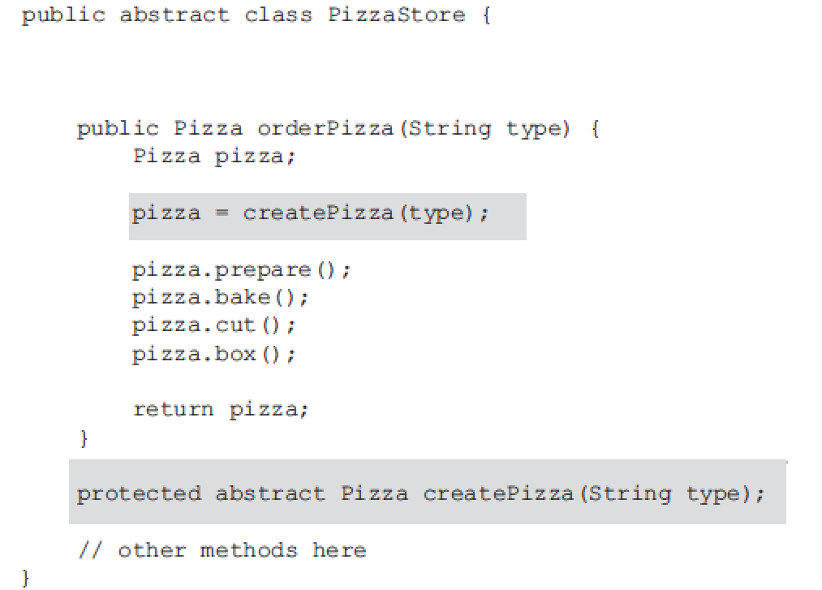
What does factory pattern need??
1.It must to isolate the client from knowing what kind of concrete product is actually created.
2.It use abstract method to connect creator and product class.
3.The factory method must to return product type.

Slide 14
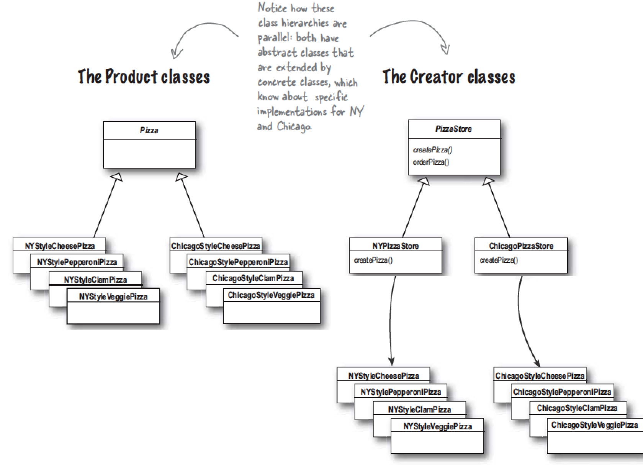
Isolate client from product

Slide 15
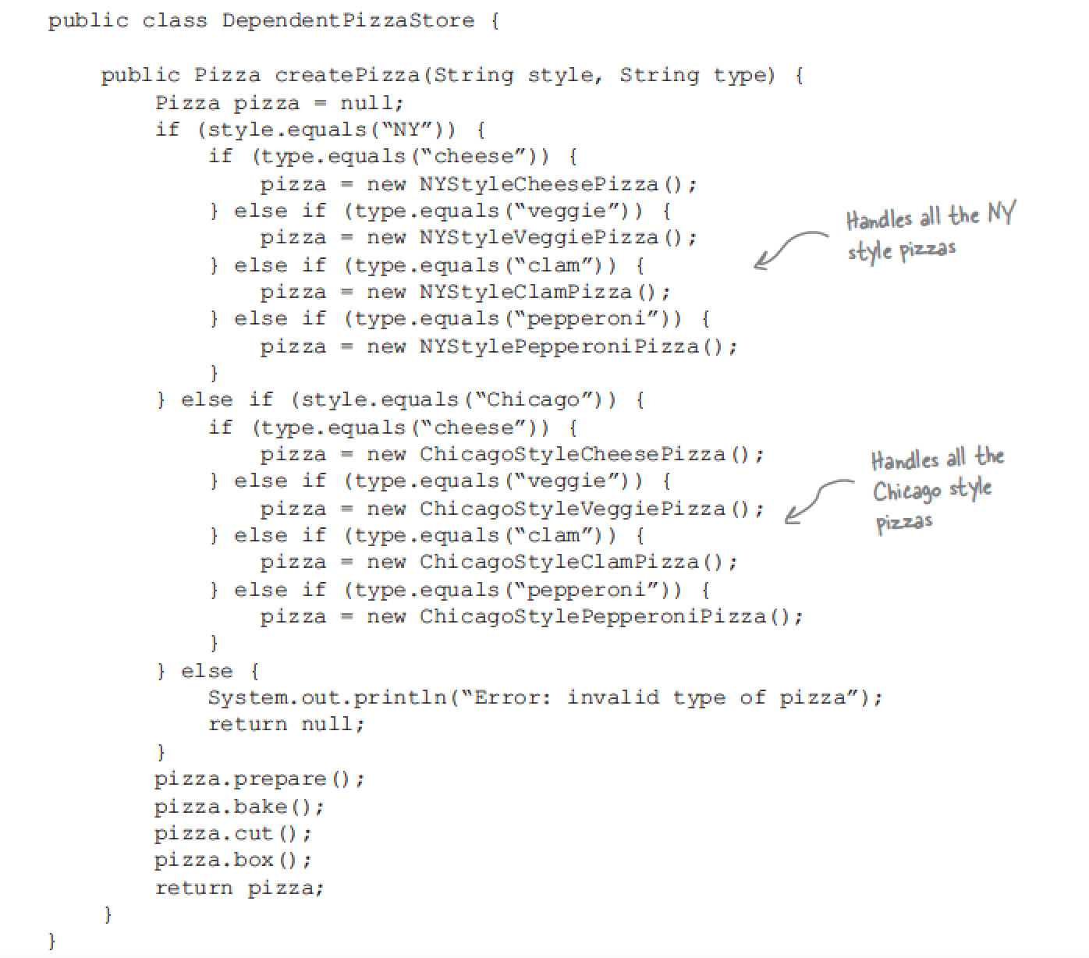
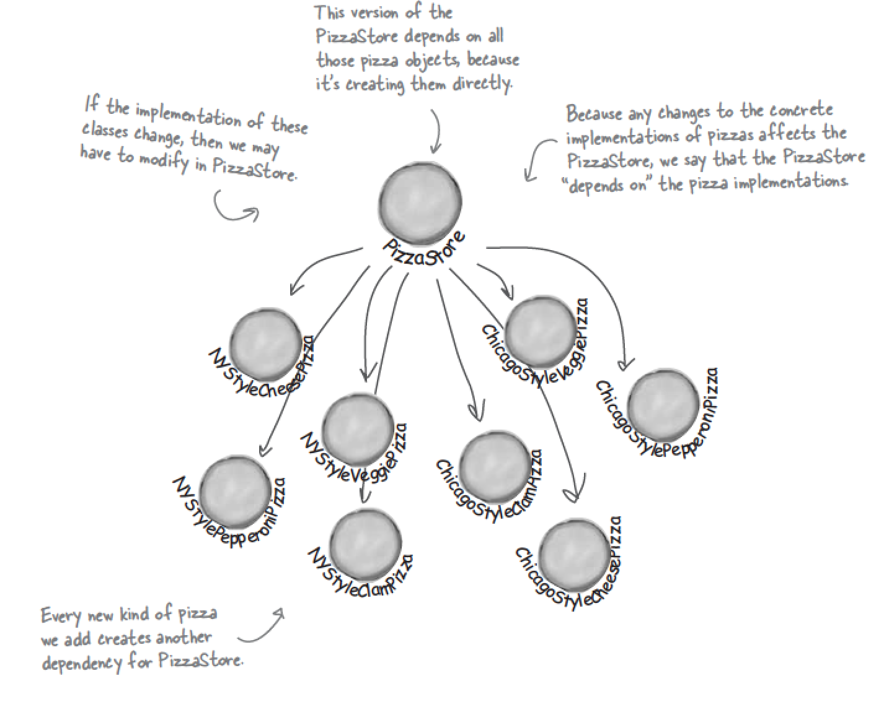
The Dependent inversion principle
Depend upon abstraction.
Do not depend upon concrete classes.

Slide 16
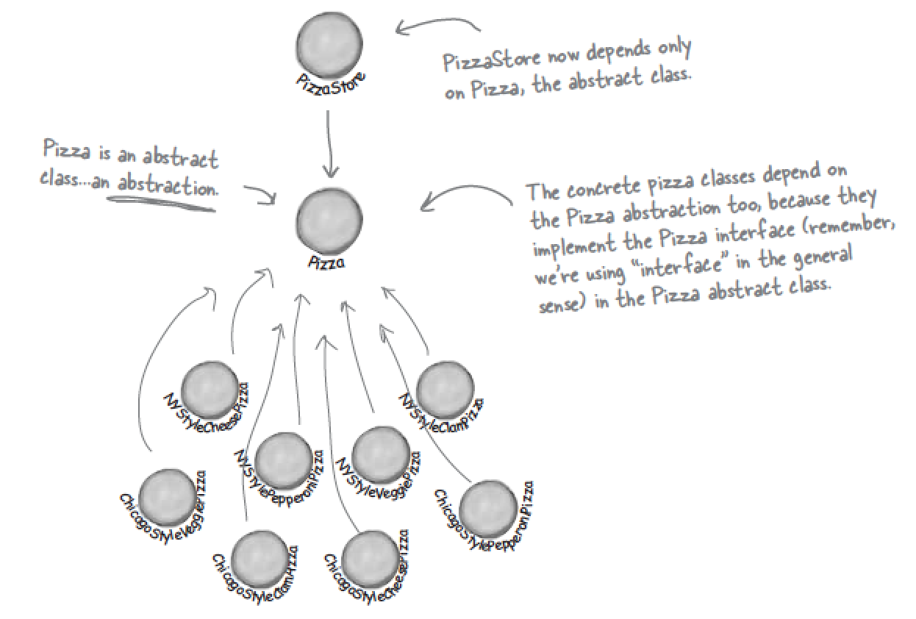
The Dependent inversion principle guidelines
No variable hold a reference to a concrete class.
No class should derive from a concrete class
No method should override an implemented method of it base classes.

Slide 17
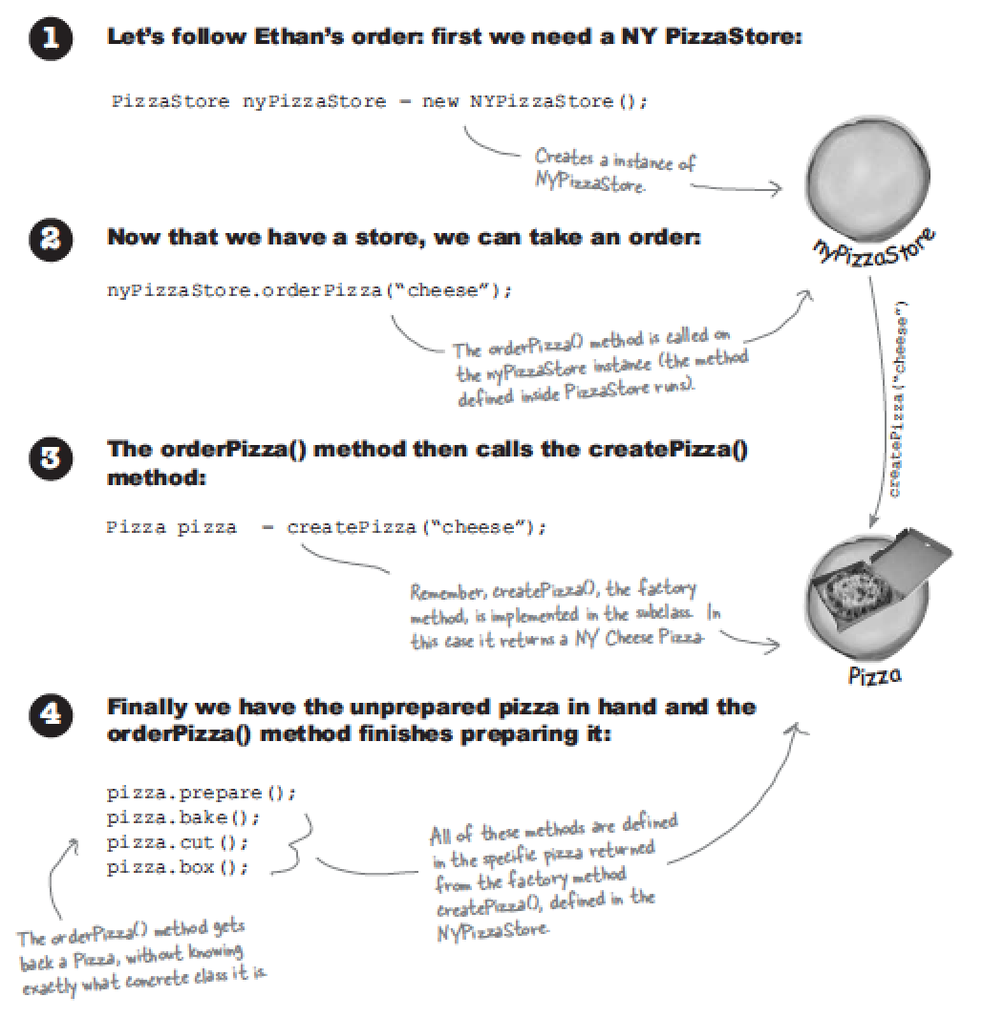
Using Factory pattern

Slide 18
Abstract Factory pattern

Slide 19
More

Slide 20
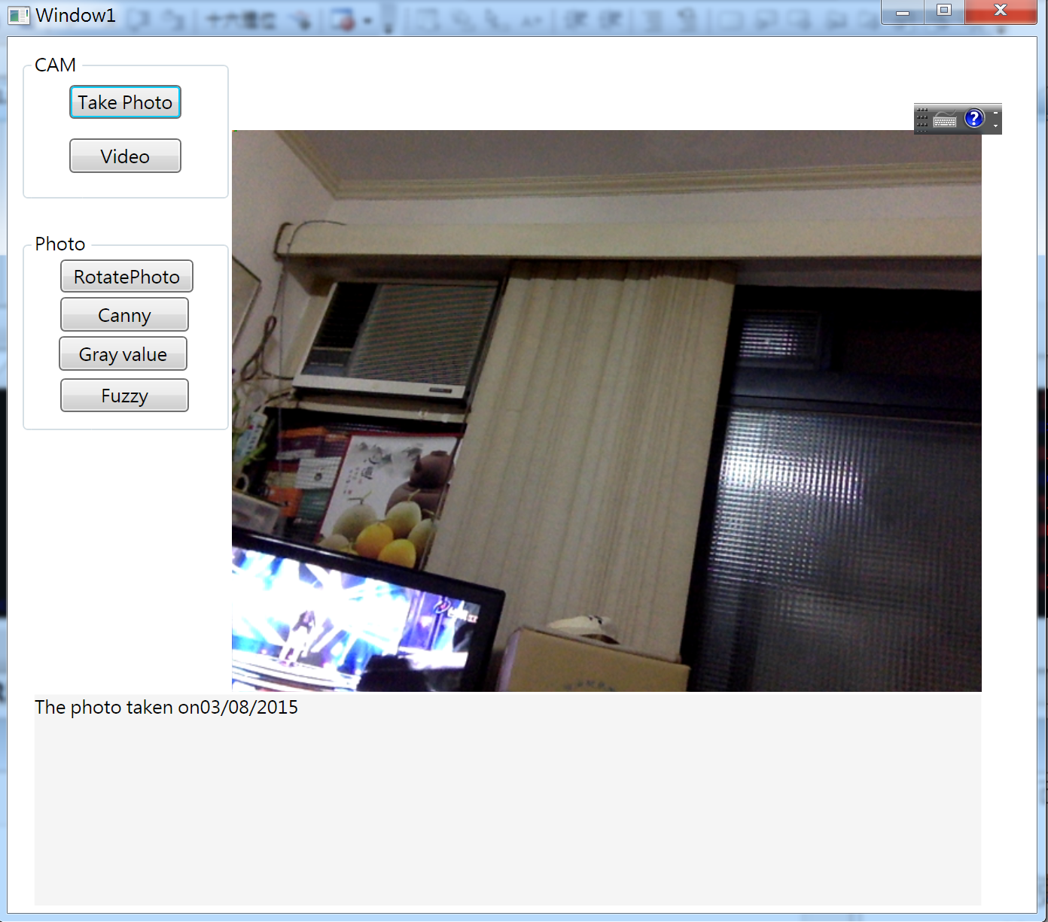
Image editor

Slide 21
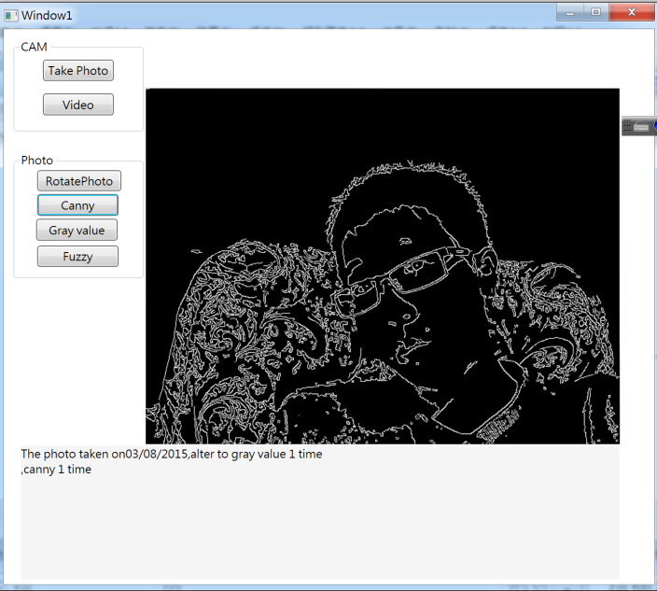
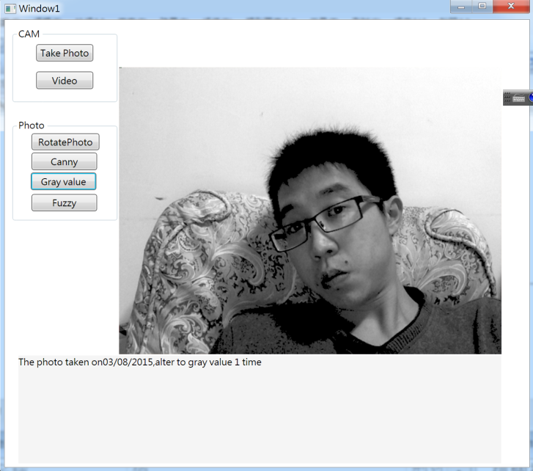
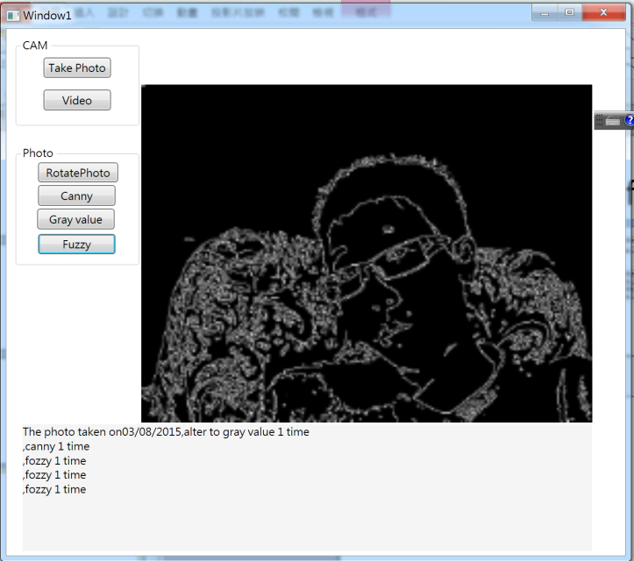
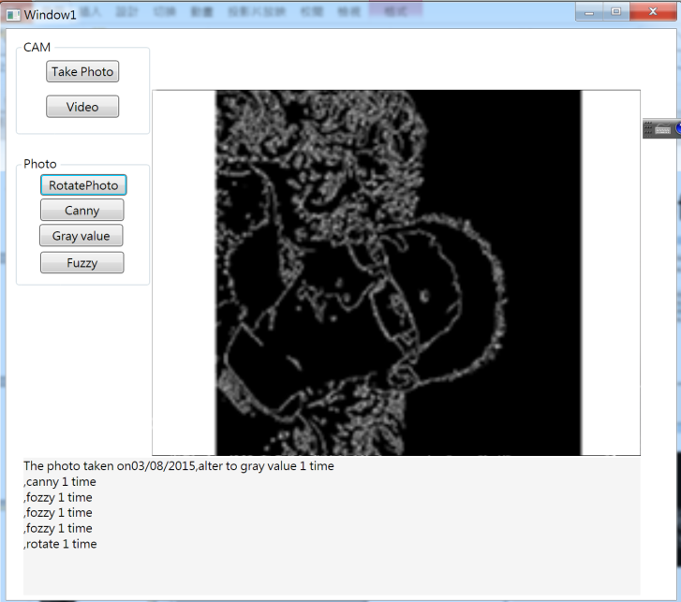
Functions of image editor

Slide 22
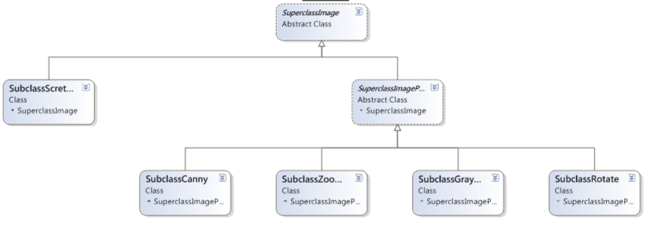
Class diagram of image editor

Slide 23
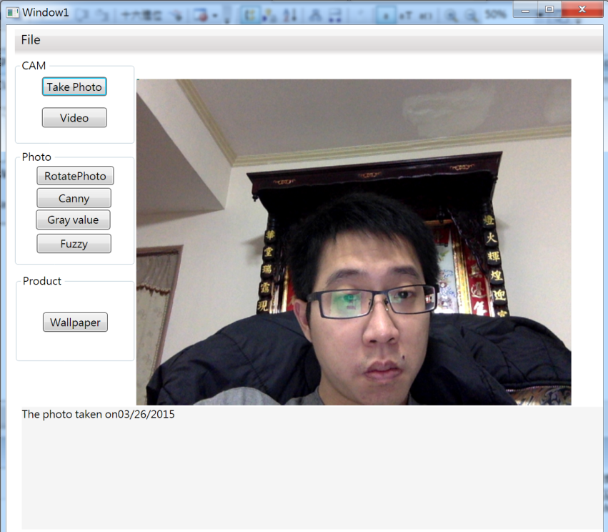
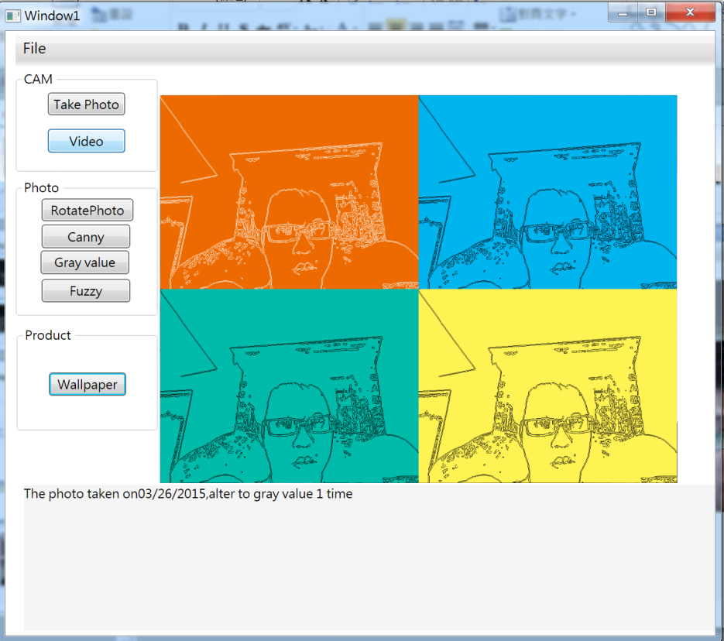
Wallpaper Product

Slide 24
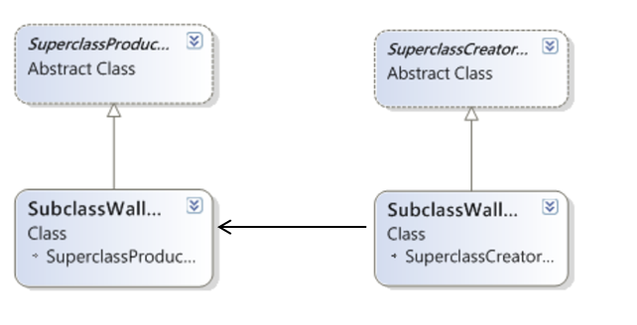
Class diagram of Wallpaper Product

